Slide 1
2. Individual Pump System
typical fuel flow pattern

Slide 2
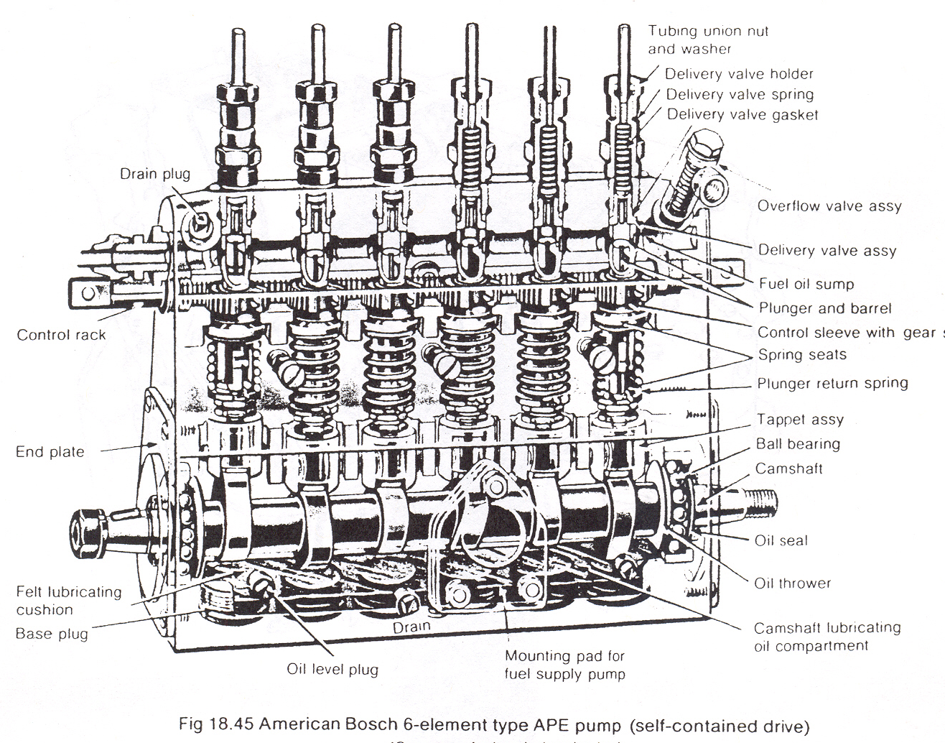
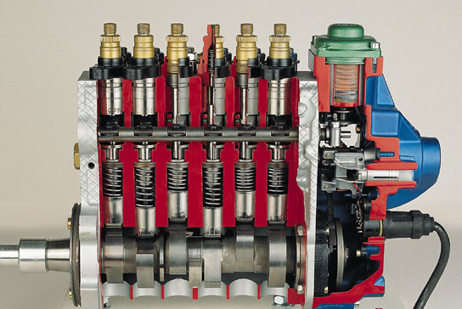
2. Individual Pump Details
Notes:
plunger travel (stroke) is fixed by cam lobe
must be timed to the engine
lobe up – potentially injecting
control rack meshes with pinion gears
push/pull rack on 4 cyl. pump

Slide 3
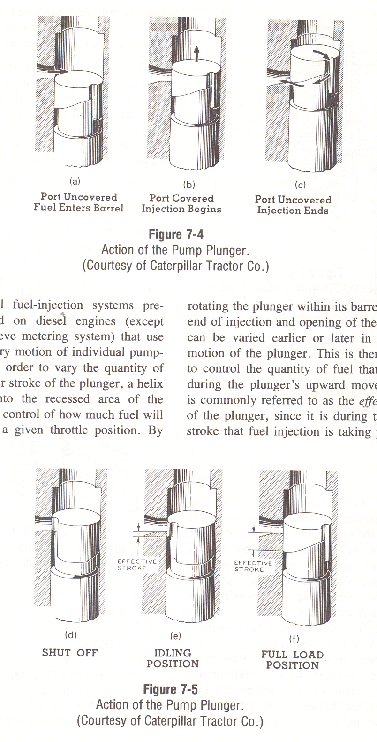
2. Plunger & Helix Operation
fuel flows into barrel
plunger travel is fixed
  dictated by the cam lobe
plunger & helix rotation
Notes:
uses port/helix metering
quantity delivered is based on port & helix position
injection lasts until spill port is uncovered
injector is opened hydraulically

Slide 4
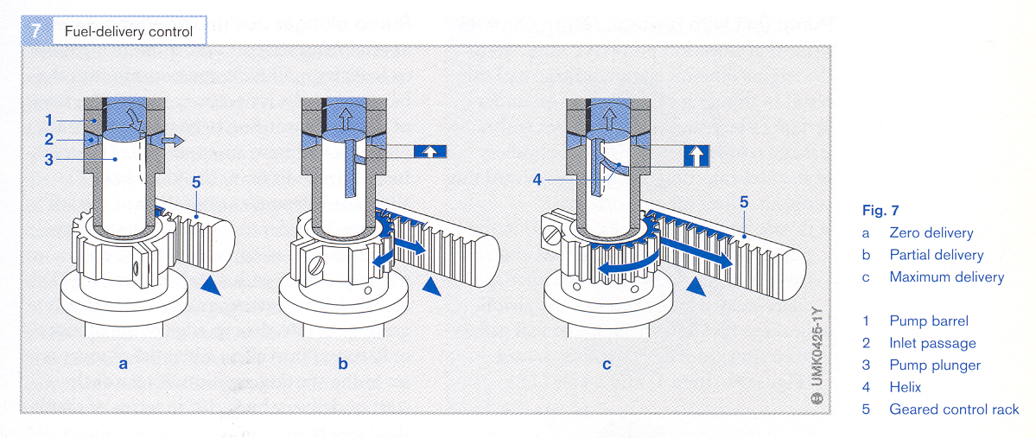
2. Control Rack & Plunger Function
fuel delivery control…
Notes:
delivery pressure 3,000 psi
spray in pressure 17,000 psi
PTR has long camshaft – can deflect cause varied fuel output, inline pump “business end” is compact

Slide 5
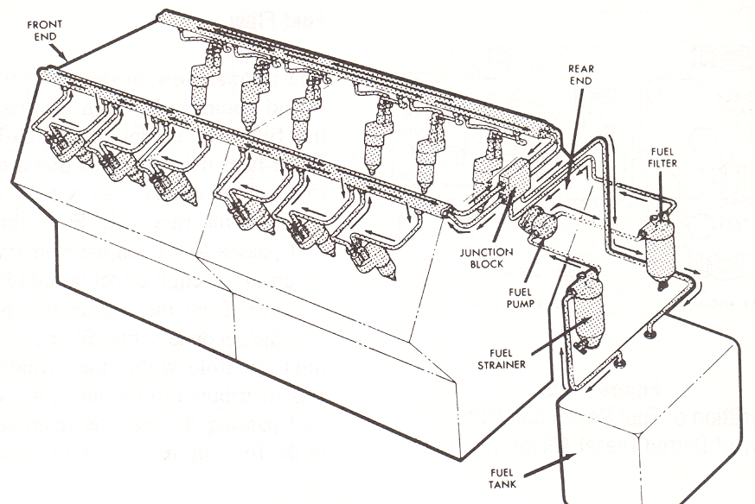
3. Unit Injection
popularized by Detroit Diesel
  (a subsiduary of General Motors)
Notes:
explain fuel flow – xfer pressure 50 -70 psi
no high pressure lines needed
similar to individual pump system
uses port/helix metering – uses engine camshaft instead of a separate pump cam

Slide 6
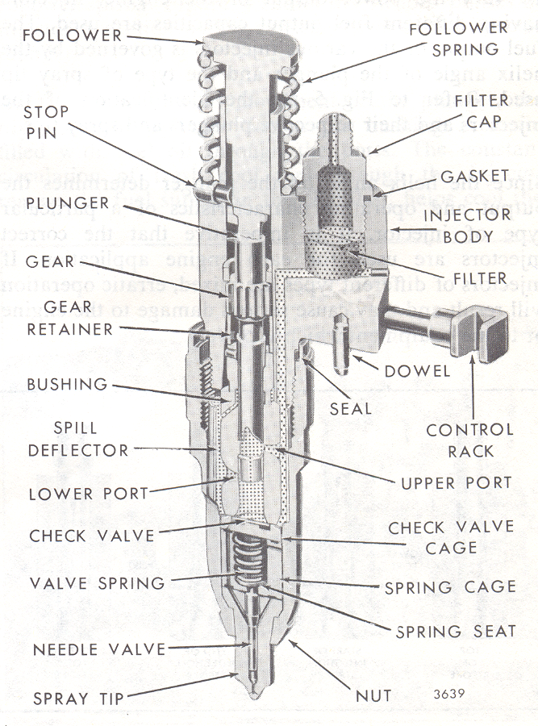
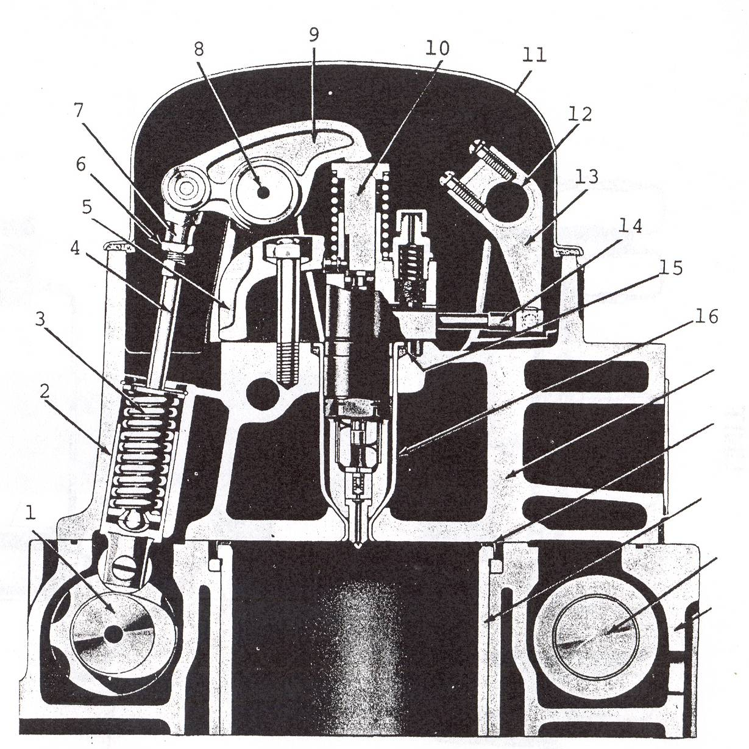
3. Unit Injection
injector is opened mechanically
  via camshaft
Notes:
uses port/helix metering – uses engine camshaft instead of a separate pump cam
demo helix movement on o/head & cam/plunger movement
times injection via control rack & plunger helix position
meters fuel quantity via helix rotation
pressurizes fuel beneath the plunger
atomizes fuel
plunger movement raises fuel pressure to 2000-3000 psi
spray-in pressure is 17,000 to 20,000 psi
speed of fuel penetration approaching 780 mph
plunger-to-bushing clearance <60 millionths of an inch (measured w/air gauge)
easy to service/swap injectors/troubleshoot

Slide 7
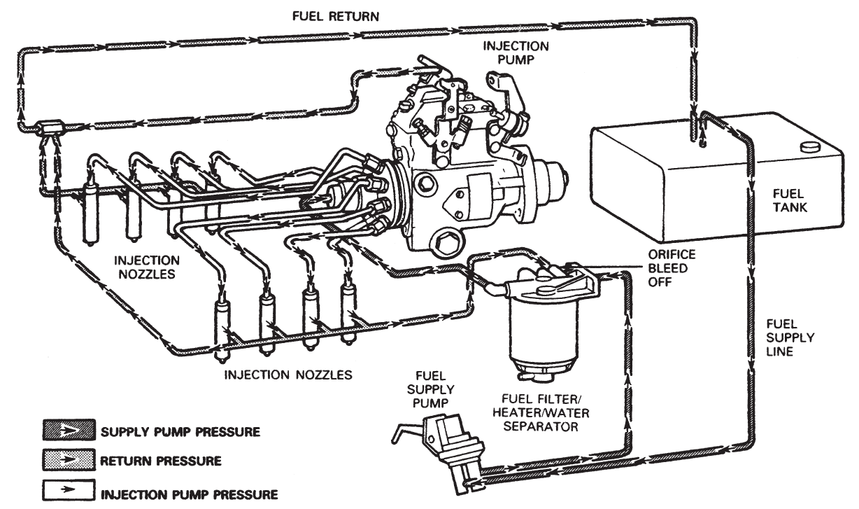
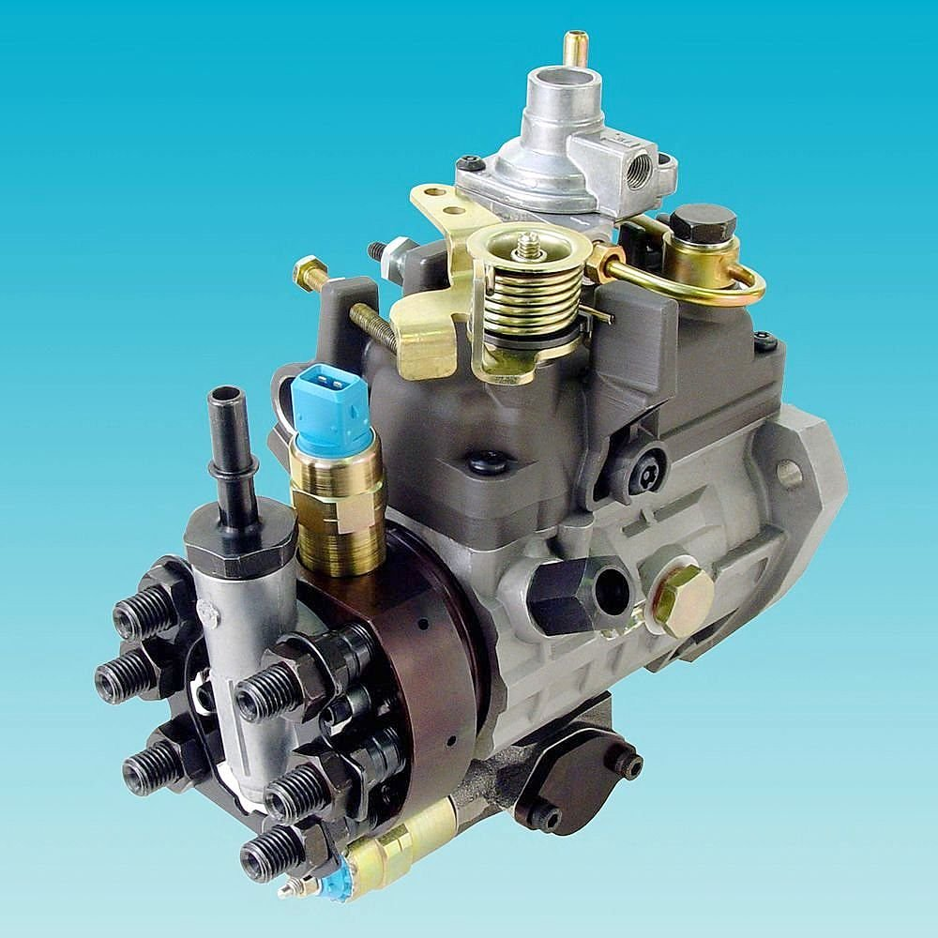
4. Rotary Fuel Distributor
used in many cars & light trucks
Notes:
injector is opened hydraulically
1 transfer pump (Xfer pressure 90–130 psi)
1 high pressure pump that feeds all cylinders
delivery pressure 3,000 psi
spray in pressure 12,000 psi (insufficient for large diesels)

Slide 8
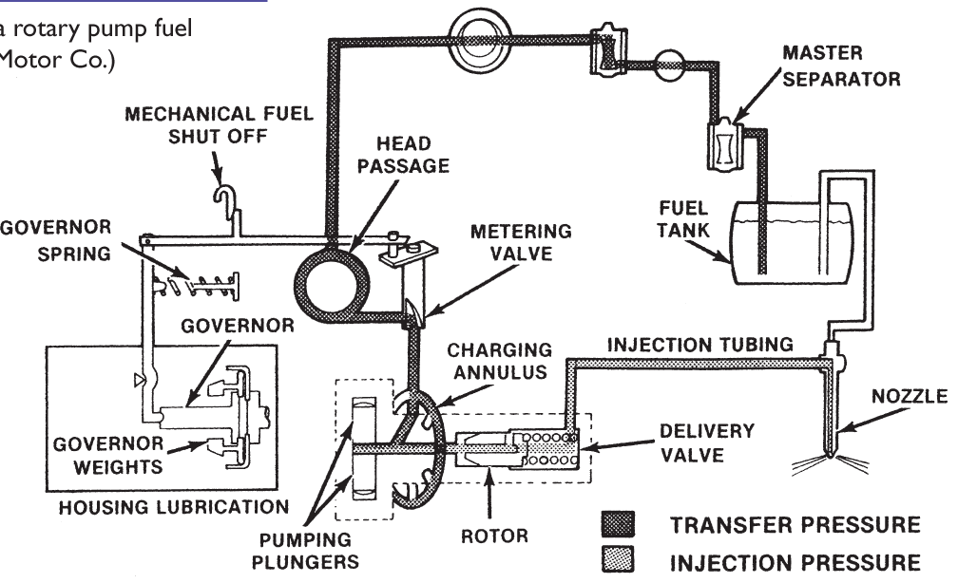
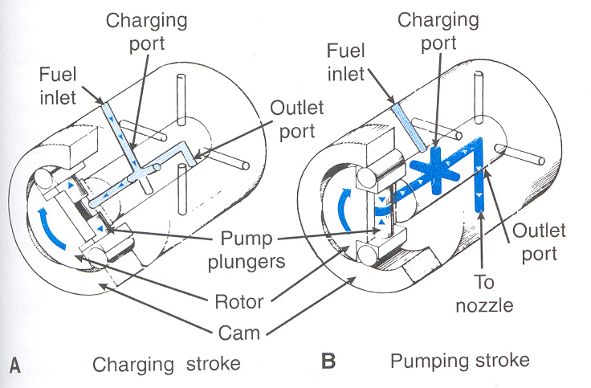
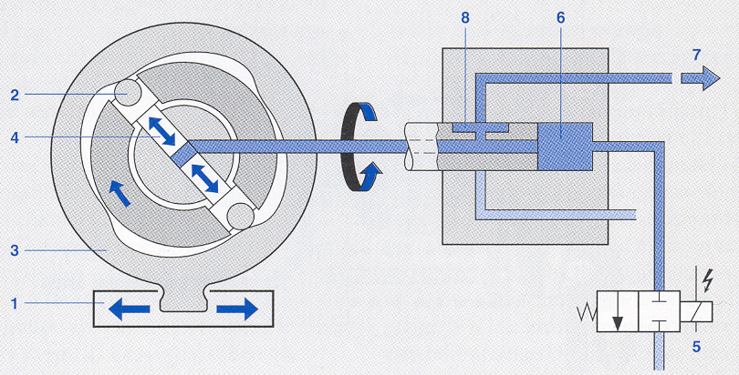
4. Rotary Fuel Distributor
Notes:
The high pressure pumping action is carried out in a single barrel, which houses two opposing plungers operated by two rollers.
These plungers are pushed together by a cam ring with internal lobes acting on the rollers and it is this action that pressurizes the fuel.
The metering valve is actuated by the throttle lever at all engine speeds above idle and by the governor linkage, when the engine is at idle or maximum speed.
The metering valve flows a measured fuel quantity into the center of the hydraulic head where the distributor rotor is turning and from there the fuel goes to the center of the rotor, which has two inlets at one end and an outlet at the other end.
As the rotor spins, the inlets line up with ports in the hydraulic head and fuel is forced out into the pumping chamber.
The pumping chamber consists of two sets of rollers, shoes, and plungers, which rotate inside a cam ring. The cam ring has lobes for each injector on the inside.
The force of the fuel entering the pumping chamber, along with the centrifugal force generated by the spinning rotor, moves the plungers apart.
The plungers move outward a by an amount directly proportional to the volume of fuel passed by the metering valve.
As the rotor turns, the cam ring lobes, squeeze the rollers together, which in turn push in the rollers.
As the plungers are pushed together, they pressurize fuel until the injectors nozzles open at their preset pop pressure.
The start of injection is defined by the setting of the cam ring.

Slide 9
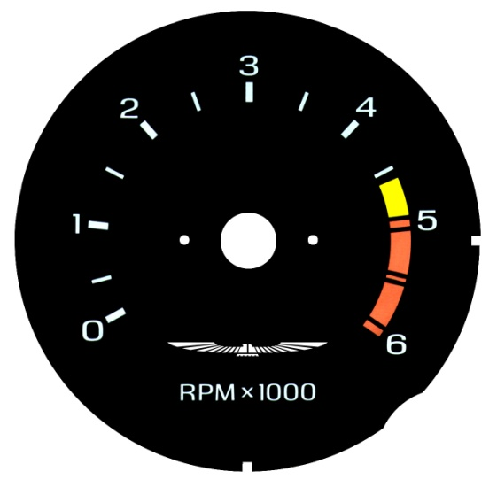
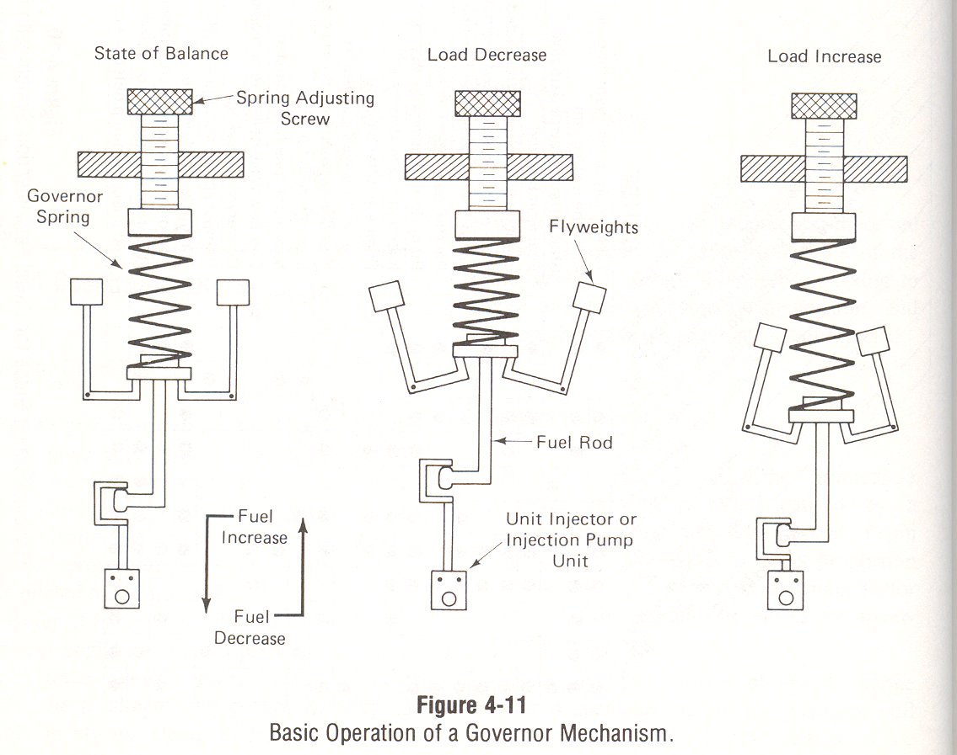
Governor Operation
spring loaded flyweights are used to…
  prevent over-revving of the engine
  control idle speed
  maintain power under load

Slide 10
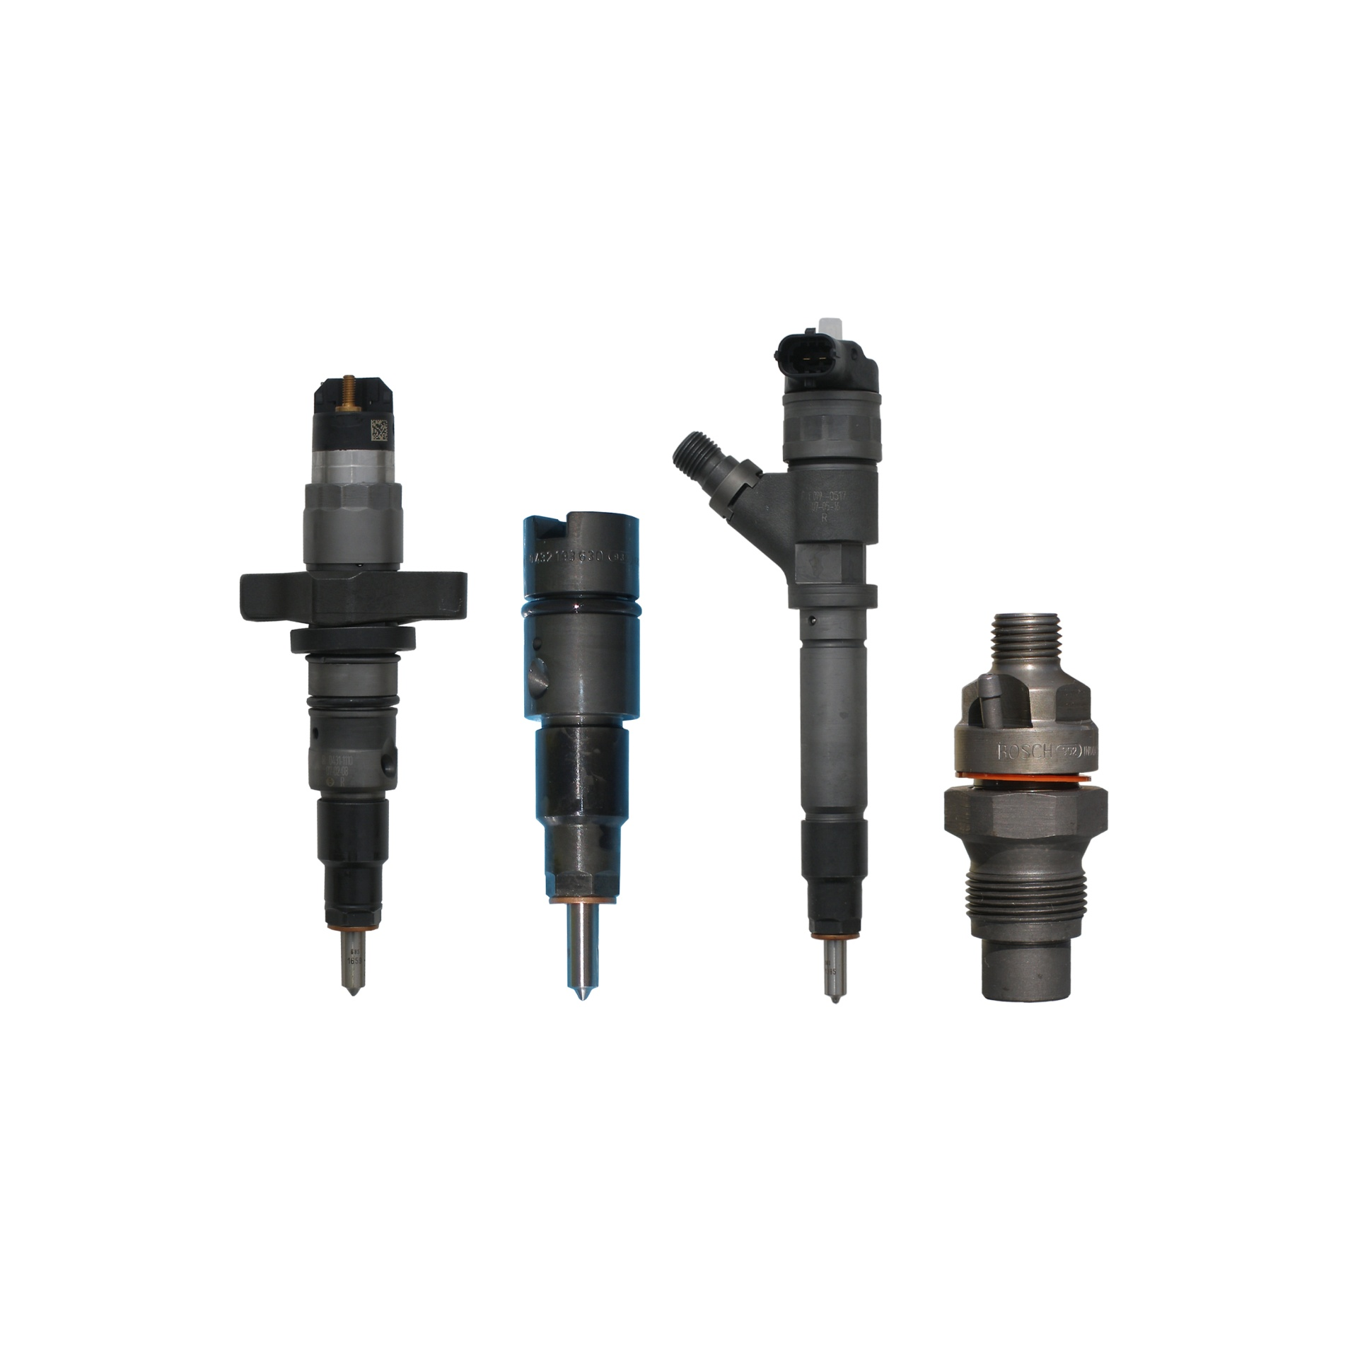
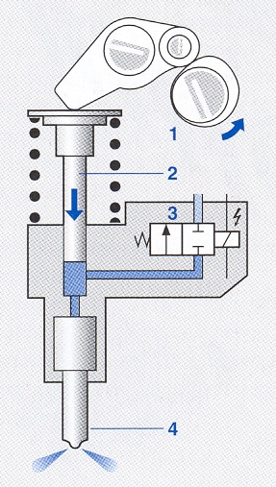
Electronic Diesel Fuel Injection
PCM controlled solenoid…
  closes fuel return passage to allow fuel injection or
  opens fuel return passage to prevent fuel injection

