Slide 1
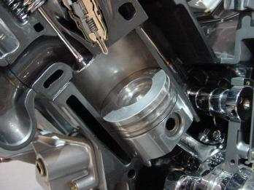
Diesel Fuel Injection

Slide 2
Diesel Fuel Injection
injection in a diesel is a necessity
with gasoline engines, fuel injection is an alternative
diesel injection systems are responsible for fuel delivery and “spark” to initiate and maintain combustion

Slide 3
Diesel Fuel Injection
6 main functions of a diesel fuel injection system…
meter (measuring of fuel) correct quantity of fuel based on the engine’s speed & load
deliver an equal quantity of fuel to each cylinder
control rate of injection (how fast fuel goes in)
time the injection relative to piston position
prevent over-speeding & maintain speed under load
atomize fuel in the cylinder so it vaporizes instantly when injected into the hot air
injection must start & stop abruptly

Slide 4
3 Main Sections – Diesel Injection Systems
Suction Side
High Pressure Side
tank
transfer pump
fuel metering
injection pump
injector
Low Pressure Side

Slide 5
Fuel Injection System Designs
4 main diesel fuel systems…
common rail
individual pump
unit injection
rotary fuel distributor
these may go by different names

Slide 6
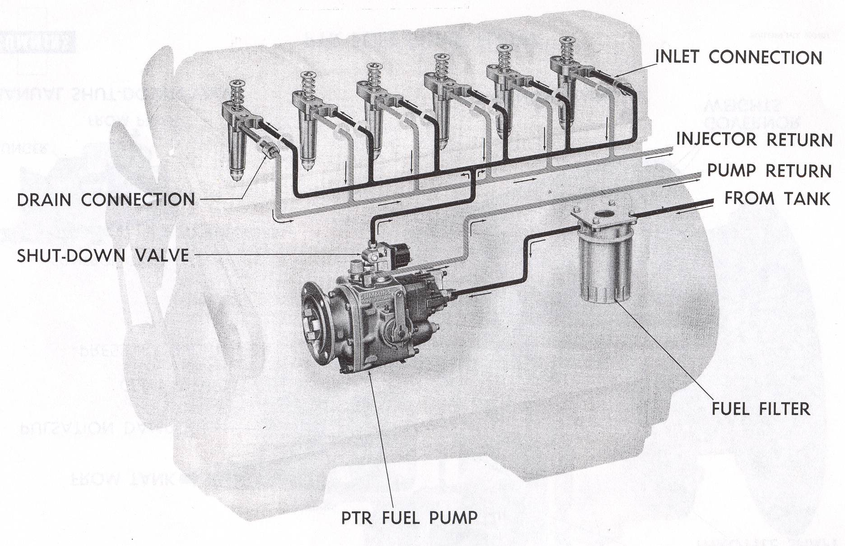
1. Common Rail Fuel System
Cummins Pressure Time Ratio (PTR)
Notes:
used on Cummins 1954 – late 80’s/early 90’s
A diesel fuel pump operates at extremely high pressures and therefore can't tolerate even a speck of dust in its super-polished interior.
The fuel pressurized by the pump must be squirted into the cylinder past the very simple, spring-loaded injector ball (whose tolerances are as little as .0002"), against an upper engine cylinder that already contains awesome pressure.

Slide 7
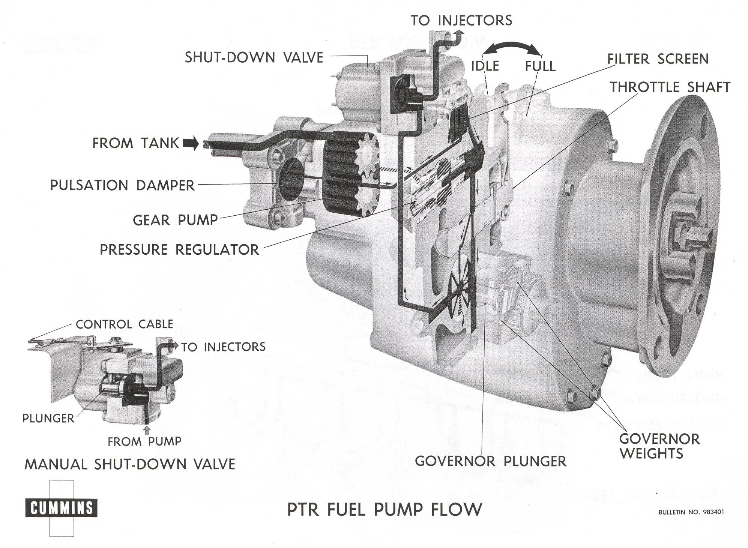
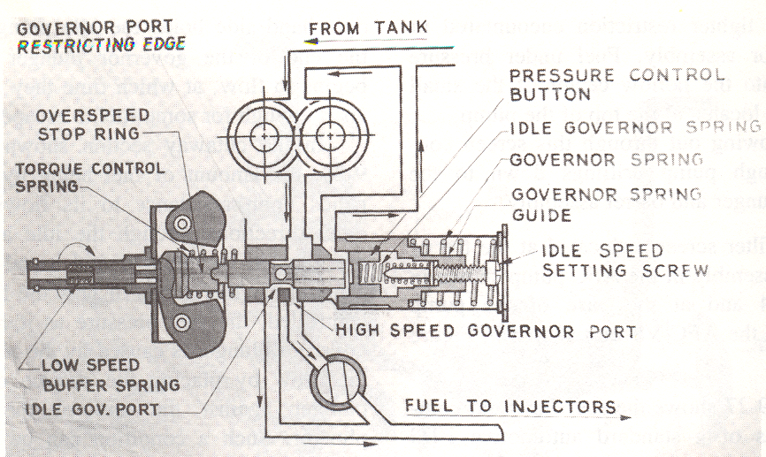
1. Common Rail Pump
Notes:
The time for metering is determined by the interval that the metering orifice in the injector remains open.
This interval is established and controlled by the engine speed, which determines the rate of camshaft rotation and consequently the injector plunger movement.
A flyball type mechanical governor controls fuel pressure and engine torque throughout the entire operating range.
It also controls the idling speed of the engine and prevents engine overspeeding in the high-speed range.
The throttle shaft is simply a shaft with a hole; therefore, the alignment of this hole with the fuel passages determines pressure at the injectors.
A single low-pressure fuel line from the fuel pump serves all injectors; therefore, the pressure and the amount of metered fuel to each cylinder are equal (approx. 250 psi)
3 advantages of PTR…
The injector accomplishes all metering and injection functions.
The injector injects a finely atomized fuel spray into the combustion chamber at spray-in-pressures exceeding 20,000 psi.
A low-pressure common-rail system is used, with the pressure being developed in a gear-type pump. This eliminates the need for high-pressure fuel lines running from the fuel pump to each injector.
FUEL FLOW…
As the operator cranks the engine, fuel is drawn from the fuel tank by the gear pump through the fuel supply line to the primary filter.
The fuel then flows through a small filter screen that is located within the PT pump assembly, and then flows down into the internal governor sleeve.
The position of the governor plunger determines the fuel flow through various governor plunger ports.
The position of the mechanically operated throttle determines the amount of fuel that can flow through the throttle shaft.
conundrum: hi rpm, less time, but we need more pressure – hence, PTR – pressure can be increased to offset the reduced time to meter at high rpm
PTR pumps can be re/re easily – no timing as injectors are timed

Slide 8
1. Common Rail Injector
injector is opened mechanically
via camshaft
Start-up stroke
Metering
Injection Complete
Injection
Notes:
PT injectors are of the unit type and are operated mechanically by a plunger return spring and a rocker arm mechanism operating off the camshaft.
There are 4 phases of injector operation, which are…
Metering —The plunger is just beginning to move downward and the engine is on the beginning of the compression stroke. The fuel is trapped in the cup, the check ball stops the fuel flowing backwards, and fuel begins to be pressurized. The excess fuel flows around the lower annular ring, up the barrel, and is trapped there.
Pre-injection —The plunger is almost all the way down, the engine is almost at the end of the compression stroke, and the fuel is being pressurized by the plunger.
Injection —The plunger is almost all the way down, the fuel injected out the eight orifices, and the engine is on the end of the compression stroke.
Purging —The plunger is all the way down, injection is complete, and the fuel is flowing into the injector, around the lower annular groove, up a drilled passageway in the barrel, around the upper annular groove, and out through the fuel drain. The cylinder is on the power stroke. During the exhaust stroke, the plunger moves up and waits to begin the cycle all over.
fuel pressure determined by rpm, governor & throttle
injector tip:≈ 8 holes, .007” diameter very hard to see
injector is cam operated
plunger stroke is ¼” – fixed dimension
needle is a mirror image of the cup

Slide 9
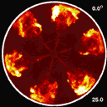
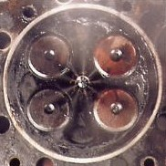
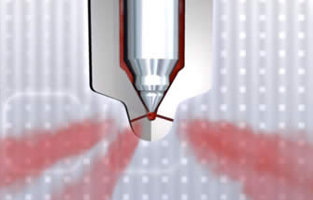

Slide 10
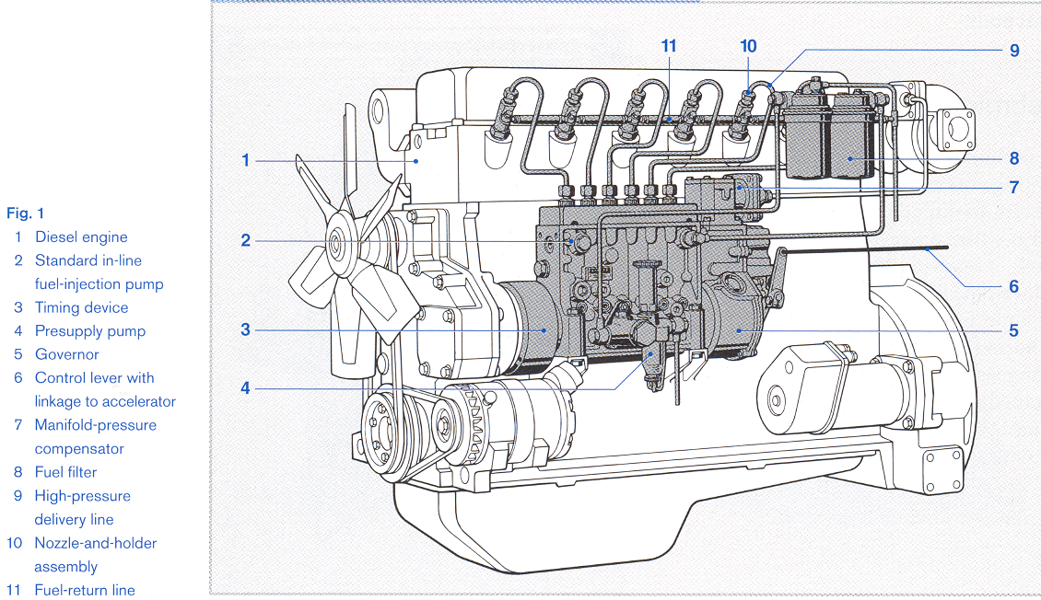
2. Individual Pump System
injector is opened hydraulically
via fuel pressure
Notes:
show pump – “battery” of pumps driven by the engine c/w Xfer pump
Xfer pump 15-60 psi or as high as 130 to 200 psi
individual high pressure lines – must all be equal length to equalize pressure
very expensive – last long time

